Slide 1
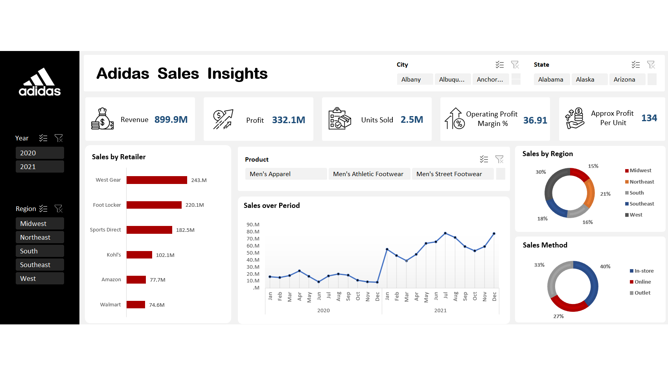
An Excel Project
-BY SAKSHI YADAV

Slide 2
CONTENT
01
EXECUTIVE SUMMARY
02
PROBLEM STATEMENT
03
RETAILER PERFORMANCE ANALYSIS
04
TEMPORAL SALES INSIGHTS
05
REGIONAL PERFORMANCE BREAKDOWN
06
CHANNEL PERFORMANCE OVERVIEW
07
PROFITABILITY ANALYSIS & EFFICIENCY OPPORTUNITIES
08
ACTIONABLE INSIGHTS & SOLUTIONS
09
KEY BUSINESS IMPACT
10
CONCLUSION & NEXT STEPS

Slide 3
Executive summary
Objective: To analyze Adidas' sales performance across retailers, regions, and sales methods using data from 2020-2021. The goal is to identify growth opportunities, optimize underperforming areas, and improve profitability.

Slide 4



Problem Statement
CHALLENGES TO ADDRESS:
Disparity in sales contributions from retailers.
Regional sales distribution is skewed towards the West.
Online sales channel underperformance compared to in-store and outlet sales.
Improving operational efficiency to enhance profit margins.
CURRENT SCENARIO:
Adidas’ sales performance is uneven across different retailers, regions, and sales channels. While certain retailers and regions are contributing significantly, others are lagging. The brand needs a strategic approach to optimize these areas and increase both sales and profitability.

Slide 5
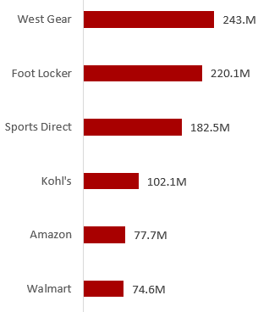

Retailer Performance Analysis
KEY FINDING:
The top three retailers account for ~71% of total sales, signaling heavy reliance on specific partners.
OPPORTUNITIES:
Amazon and Walmart: These online giants have underperformed, potentially due to lack of digital focus or stock management issues.
Optimization Strategy: Leverage e-commerce marketing, adjust inventory, and introduce exclusive online products to boost their performance.

Slide 6
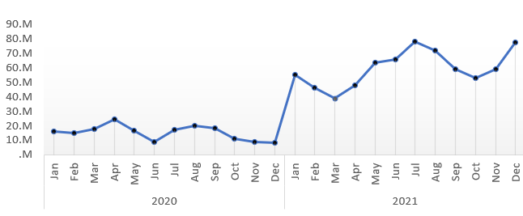
Temporal Sales Insights
SEASONALITY EFFECT:
Strong sales in mid-2021 indicate a potential seasonal demand spike. Capitalizing on similar periods in future years with targeted marketing campaigns could drive higher sales.
2020 IMPACT:
Lower sales in 2020 are likely influenced by global disruptions, pointing to the need for agile strategies to respond to external factors like supply chain issues.

Slide 7
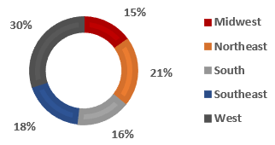
Regional Performance Breakdown
KEY FINDING:
The West region dominates sales, while the Midwest significantly underperforms.
OPPORTUNITY FOR GROWTH:
Midwest Expansion: Invest in new retail outlets, enhanced distribution, and localized marketing campaigns to boost Midwest sales.
Northeast & Southeast Focus: With 21% and 18%
respectively, these regions have potential for further
growth through improved targeting of customer
demographics and expansion in underpenetrated
cities.

Slide 8
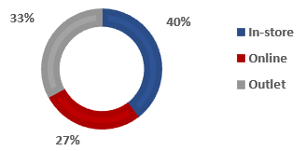
Channel Performance Overview
ONLINE CHANNEL GROWTH:
Online sales underperform in comparison to physical outlets despite the global shift towards e-commerce.
OPPORTUNITIES:
Digital Transformation: Enhance digital marketing efforts (SEO, social media campaigns), streamline online shopping experiences, and offer exclusive products online.
Omni-channel Strategy: Improve online-to-offline integration (e.g., click-and-collect), and create a seamless customer journey between digital and physical stores.

Slide 9
Profitability Analysis & Efficiency Opportunities
Efficiency Improvement:
While the 36.9% margin is competitive, there are still opportunities to increase efficiency across supply chains, warehousing, and logistics to reduce operational costs.
Focus Areas:
Cost Reduction: Negotiate better terms with suppliers and retailers, optimize distribution routes, and reduce operational waste.
SKU Rationalization: Focus on high-margin products and reduce the volume of low-performing SKUs to increase overall profitability.

Slide 10
Actionable Insights & Solutions
RETAILER STRATEGY:
Amazon & Walmart: Increase focus on digital sales strategies, enhance inventory management, and offer exclusive products.
West Gear & Foot Locker: Continue nurturing top-performing retailers, potentially offering them higher stock of limited-edition or new products to maintain sales growth.
REGIONAL GROWTH OPPORTUNITIES:
Midwest Focus: Expand presence through new outlets, targeted marketing campaigns, and improved distribution.
Southeast & Northeast: Strengthen penetration in key cities, and tailor marketing to regional preferences.

Slide 11

SALES METHOD OPTIMIZATION
Online Growth: Invest in improving the online shopping experience and enhancing digital marketing.
Omni-channel Approach: Integrate online and offline strategies (e.g., click-and-collect, online-to-store promotions).

Slide 12
Key Business Impact
REVENUE GROWTH POTENTIAL:
ENHANCED PROFIT MARGINS
STRENGTHENING DIGITAL PRESENCE
By optimizing underperforming retailers and regions, there’s a potential to boost overall revenue by 10-15% in the next fiscal year.
Operational improvements could increase profit margins by 2-3%, resulting in $25M-$30M additional profit.
Expanding the online channel could lead to an additional 5-10% revenue growth in the e-commerce segment alone.

Slide 13
Develop targeted retailer-specific strategies to improve sales performance.
Focus marketing and sales efforts on underperforming regions like the Midwest.
Invest in digital transformation and enhance the e-commerce experience.
Implement cost-reduction initiatives to improve operational efficiency and boost profit margins.
Next Steps

Slide 14
Adidas is performing well, with strong sales and profitability, but there are key areas for growth. Retailer and regional discrepancies, underperforming online channels, and operational inefficiencies are the primary challenges to address.
Conclusion

Slide 15
THANK YOU
Your thoughts and insights are greatly appreciated as we work towards achieving better business outcomes together.
Feel free to reach out for any further questions or clarifications.

